Slide 1


Automatic Question Generation using NLP
Team Dynamic Data Trio { 1 -> 12 -> 39 }

Slide 2
Table of contents
01
02
03
04
Problem
Solution
Why should we Care about it?
How can we Solve it?
Pipeline
Live Demo
Overview of Our Solution
Can we Skip to the Good Part?

Slide 3



Whoa!
Let’s Begin!

Slide 4

01
Problem
Why Should we Care about it?

Slide 5





Problem
Creating Questions from Piece of Context is Manual and Not Scalable.
Educators & Books Publishing House all over the world are Facing this Serious Problem.

Slide 6

How can we Solve it?
Chapter 6 Social Studies
The Amazon River
The Amazon in South America is the largest river by discharge volume of water in the world, and the second-longest river in the world.
The total length of the river as measured from the headwaters of the Ucayali-Apurímac river system in southern Peru is at least 4,000 miles (6,400 km), which makes it slightly shorter than the Nile River but still the equivalent of the distance from New York City to Rome.
Which is Second Longest River in World?
A
Nile
B
Amazon
C
Mississippi
D
Yangtze

Slide 7

02
Solution
How can we Solve it?

Slide 8
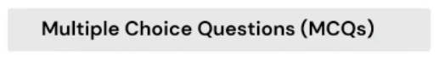
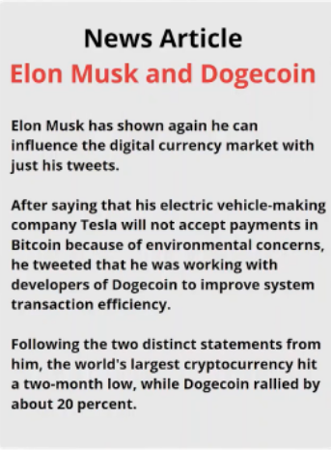
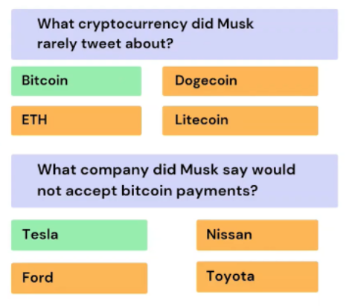
Final End Product

Slide 9
Step 1 : Summarization
Chapter 6 Social Studies
The Amazon River
The Amazon in South America is the largest river by discharge volume of water in the world, and the second-longest river in the world.
The total length of the river as measured from the headwaters of the Ucayali-Apurímac river system in southern Peru is at least 4,000 miles (6,400 km), which makes it slightly shorter than the Nile River but still the equivalent of the distance from New York City to Rome.
The Amazon in South America is
the largest river by discharge
volume of water in the world, and
the second-longest river in the
world.
Find important
Sentences
(Abstractive or
Extractive
Summarization)

Slide 10
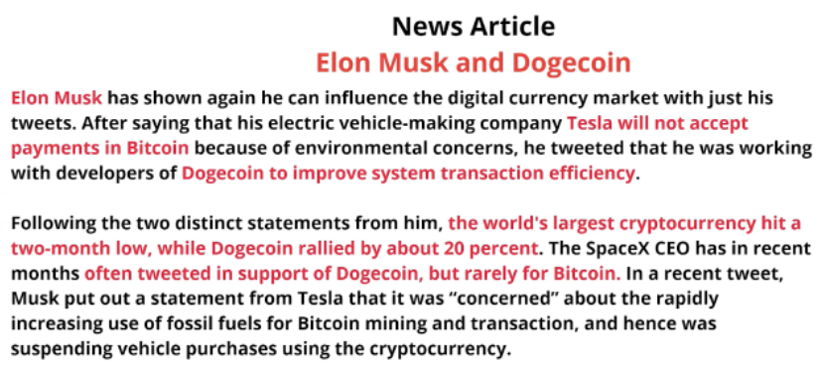



Step 1 : Summarization

Slide 11
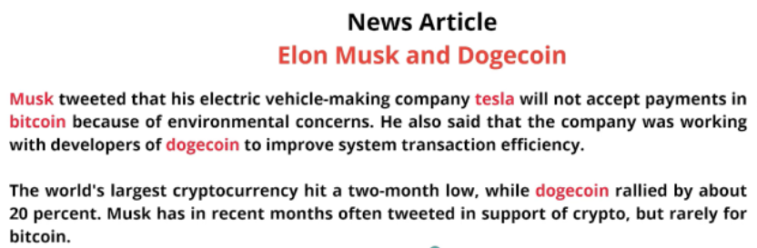
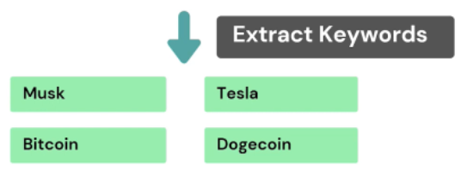
Step 2 : Identify Keywords from Sentence

Slide 12
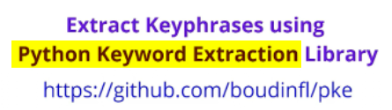
Step 2 : Identify Keywords
Bitcoin, Dogecoin, Tesla, Cryptocurrency
Multi-Partite Graph Model in PKE

Slide 13
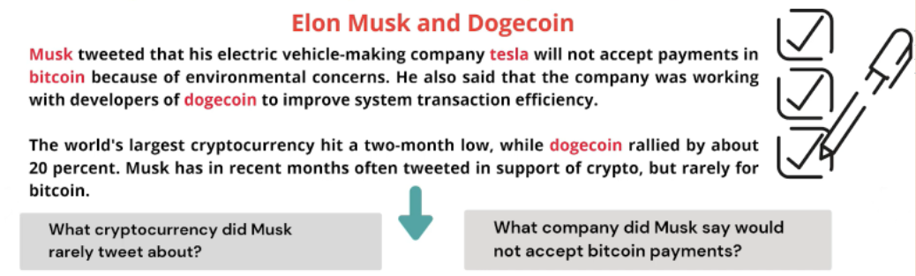
Step 3 : Generate Question

Slide 14
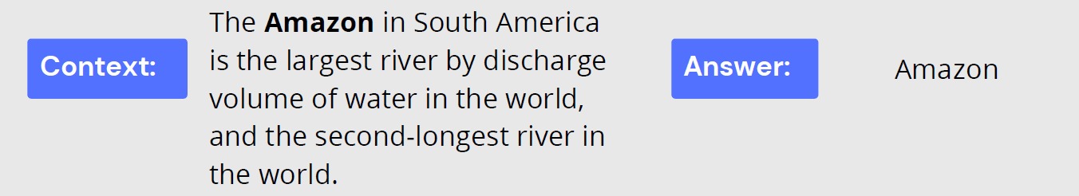
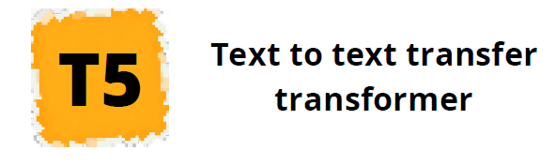
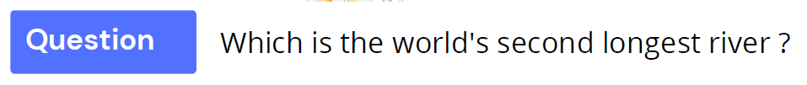
Step 3 : Generate Question using T5 Transformer Model

Slide 15
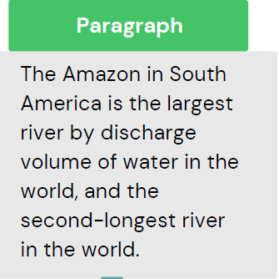
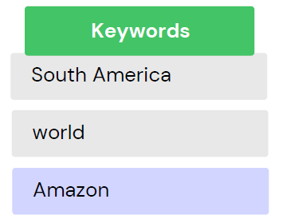
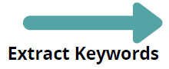
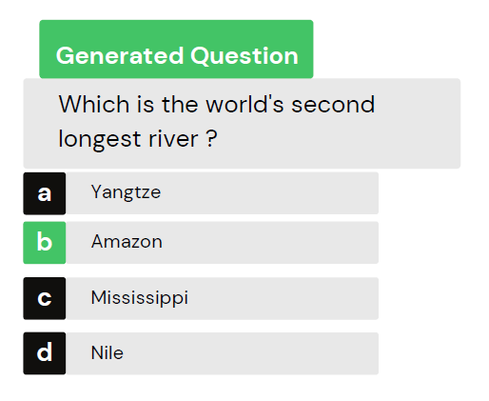
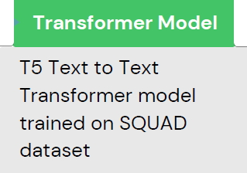
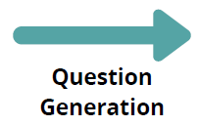
Step 3 : Generate MCQ from Any Content
Pick a Keyword Eg: Amazon

Slide 16
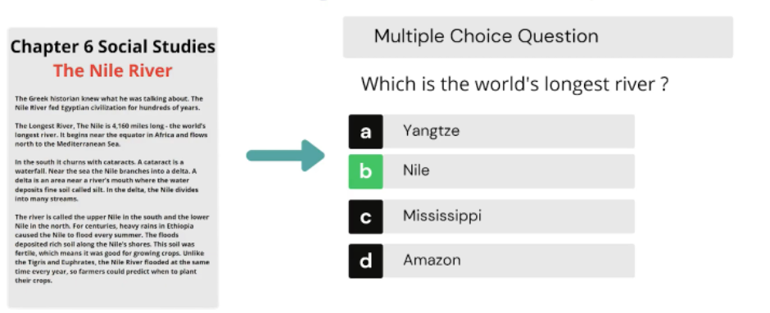
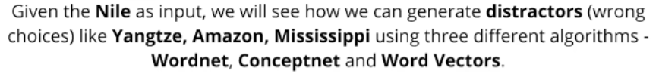
Step 4 : Generate Wrong Choices for MCQ Option

Slide 17
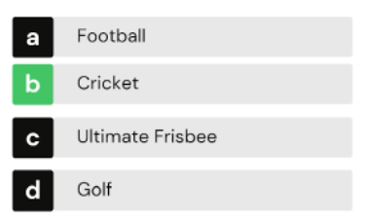
4.1 : What is WordNet?
https://wordnet.princeton.edu/
WordNet@ is a large lexical database of English.
Similar to thesaurus but captures even broader
relationships between words.
WordNet is also free and publicly available for
download.
WordNet labels the semantic relations among words. Eg: Synonyms - Car and Automobile
WordNet also captures the different senses of a word. Eg: Mouse could mean an animal or computer mouse.

Slide 18
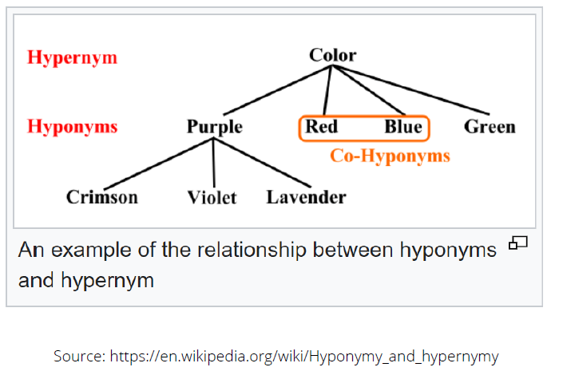
4.1 : Generate Distractors using WordNet
https://wordnet.princeton.edu/
WordNet@ captures relations.
A hyponym is in a type-of relationship with its hypernym.
A hypernym is an umbrella term and
blanket term. Eg: Color is the hypernym for Purple.
Red, Blue, Green are the Hyponyms of "Color". Since Red is a type of color.
Our goal is to extract Co-Hyponyms as Distractors.

Slide 19
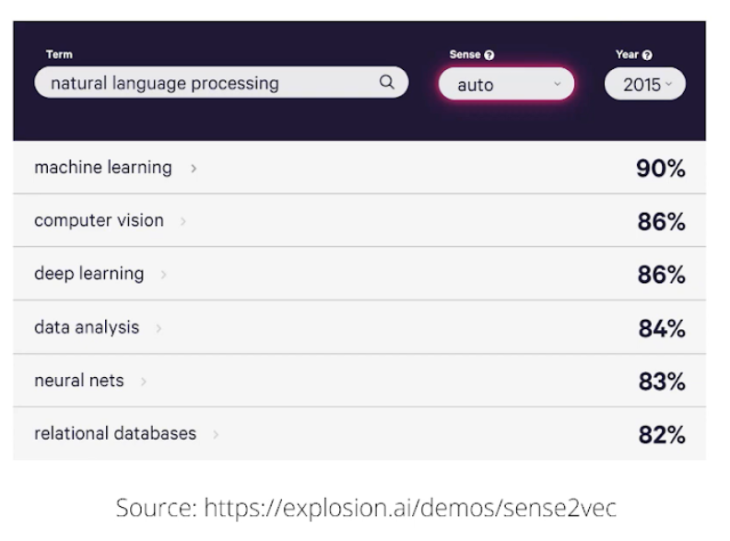
4.2 : Generate Distractors using Sense2Vec
https://explosion.ai/blog/sense2veaeloaded
Contextual information is captured. Trained on Reddit comments.
The words with the same senses are differentiated with parts of speech Eg: duck l VERB and duck I NOUN
Noun phrases and named entities are annotated during training so multiword phrases like "natural language processing" also have an entry as opposed to some word vector algorithms which are trained with only single words.
We will use 2015 trained vectors as opposed to 2019 as the results were slightly better in our experimentation.

Slide 20

03
Pipeline
Overview of Our Solution

Slide 21
Posing it as an NLP problem
News Article
Elon Musk and Dogecoin
Elon Musk has shown again he can influence the digital currency market with
just his tweets.
After saying that his electric vehicle-making company Tesla will not accept payments in Bitcoin because of environmental concerns. he tweeted that he was working with developers of Dogecoin to improve system transaction efficiency.
Following the two distinct statements from him, the world's largest cryptocurrency hit a two-month low, while Dogecoin rallied by about 20 percent.
1
Abstractive / Extractive Summarization (T5 Transformer.)
2
Paraphrasing of Sentences (T5)
3
Keyword / Keyphrase Extraction ( YAKE, TopicRank, KeyBERT etc)
4
Question Generation (T5)
5
Wrong Choices/Distractors Generation
(WordNet, ConceptNet, Sense2Vec).

Slide 22

Live Demo
Google_Collab_Link

Slide 23



Quiz Time
Code : 8649 4630
Link : www.menti.com
JUST 3 MINS QUIZ!
Top 5 Winners

Slide 24

5
Future Scope
What can be Improved?

Slide 25
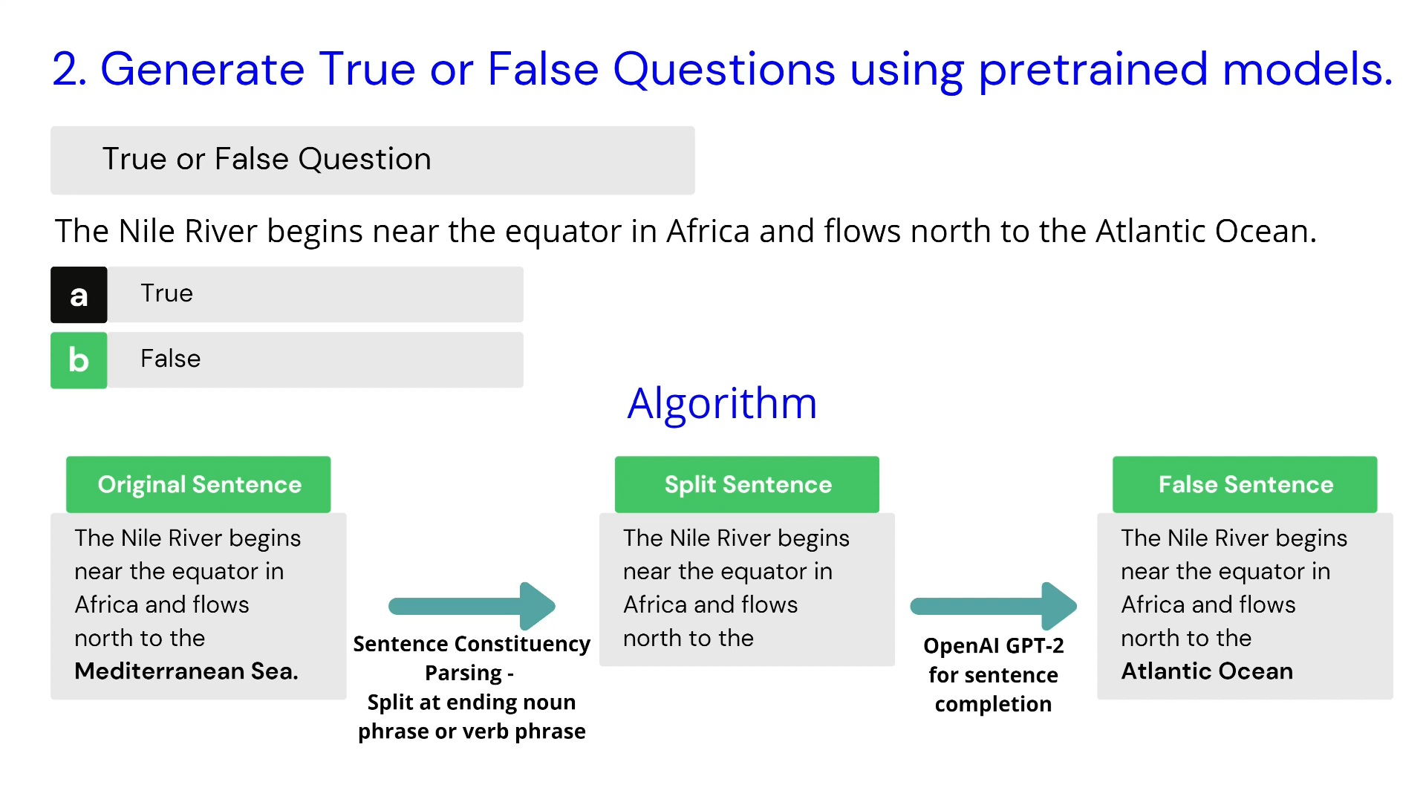

Slide 26
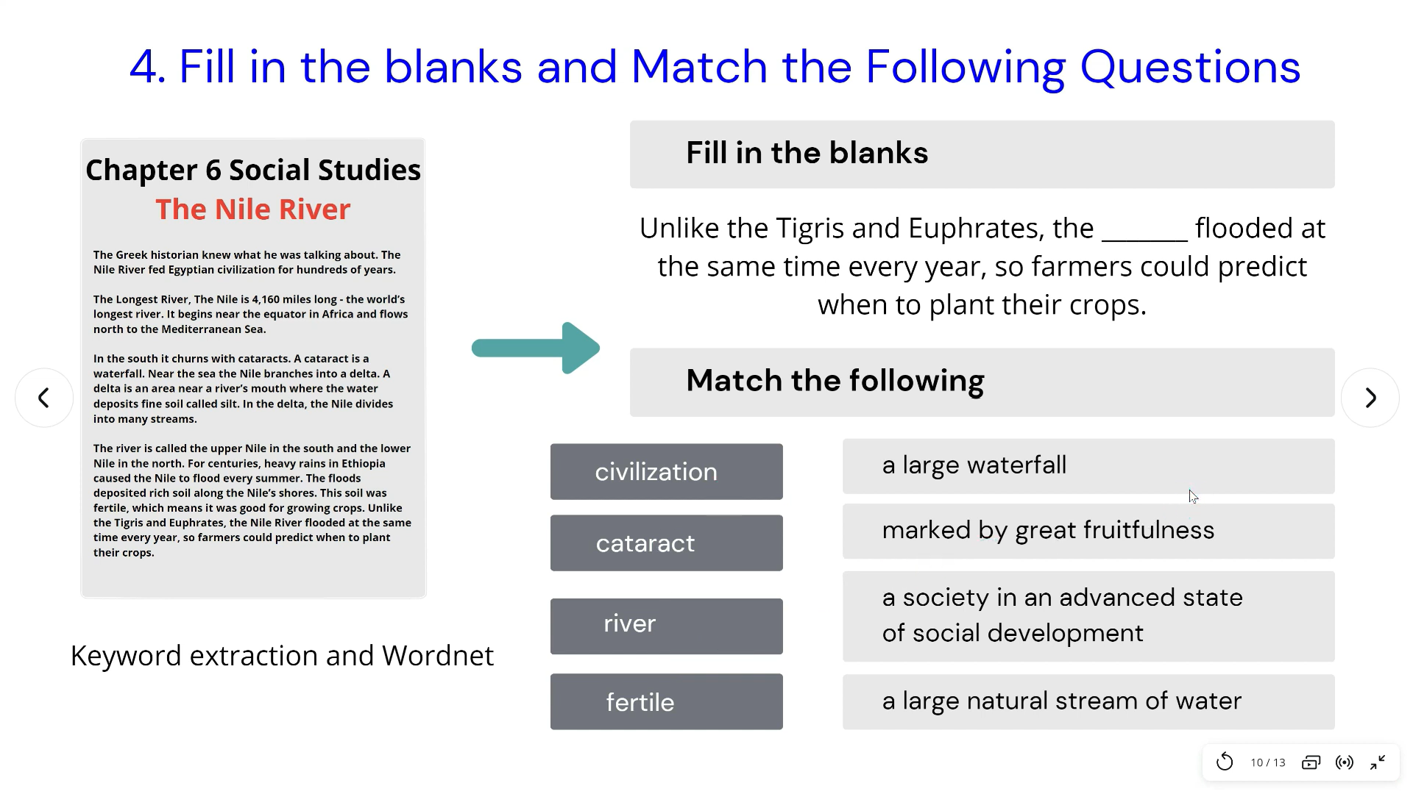

Slide 27
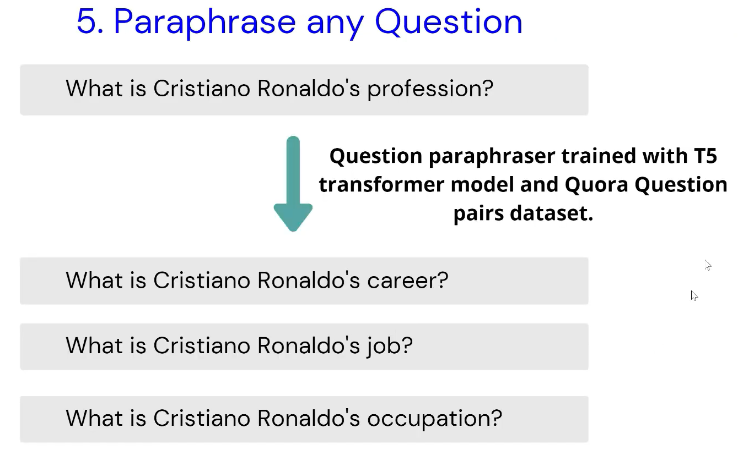

Slide 28



Dynamic Data Trio
Parva Patel
Bhagya Rana
Neel Shah
U19CS001
U19CS012
U19CS039

